Slide 1


Team 54: ECEN215 Lab Kit 2
Bi-Weekly Update 5 Gavin Bernard
Maylun Huang
Evan Slyter
Sponsor: John Lusher TA: Hailey Ward
Notes:
Michelle

Slide 2
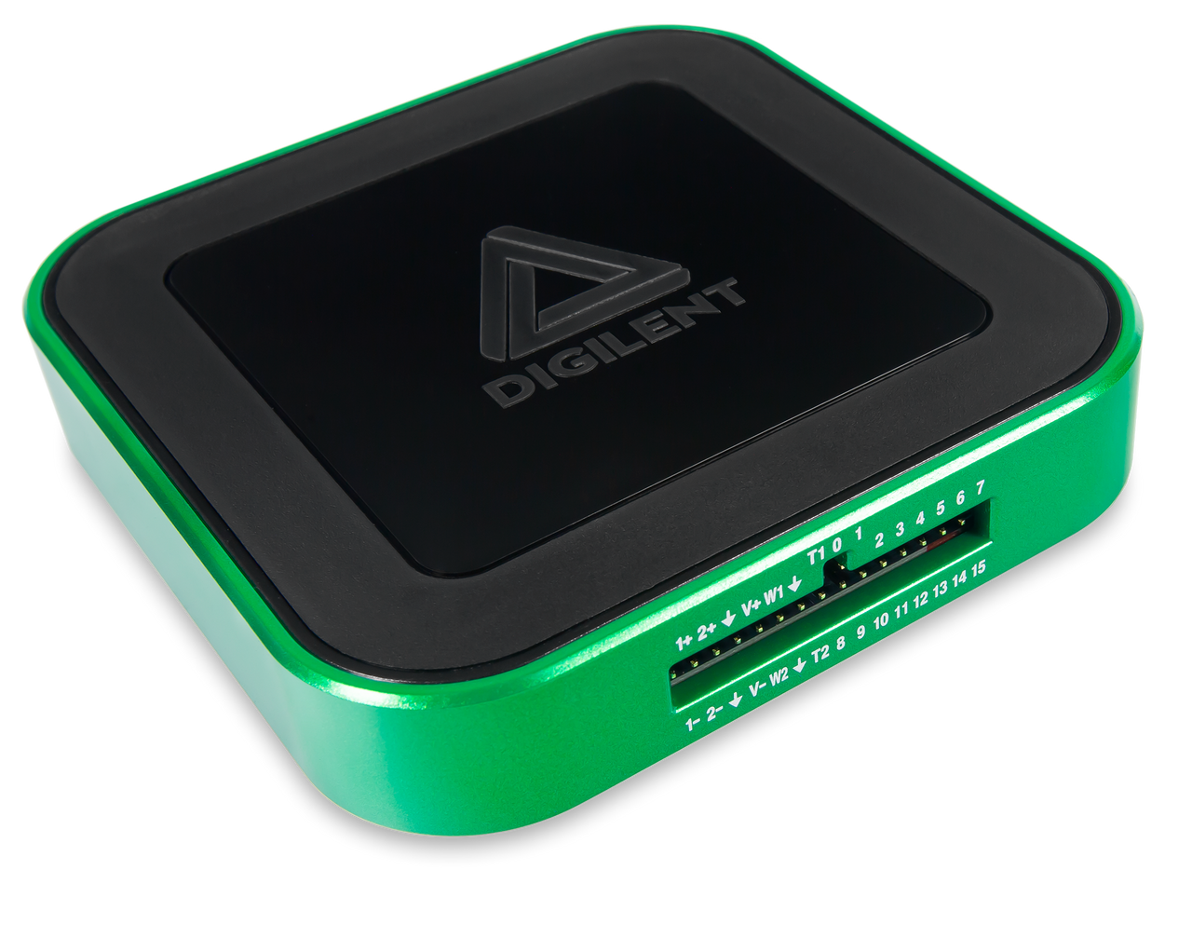
Project Summary
Problem statement:
Access to an affordable, course-specific solution for distance-learning students to complete ECEN215 Labs is minimal.
Our Solution:
An affordable, self-contained system that enables hands-on measurements and intuitive data displays.
Complete production of labkit for $50-$75
Easily transportable by hand.
AD3: $379
Notes:
Kyle

Slide 3

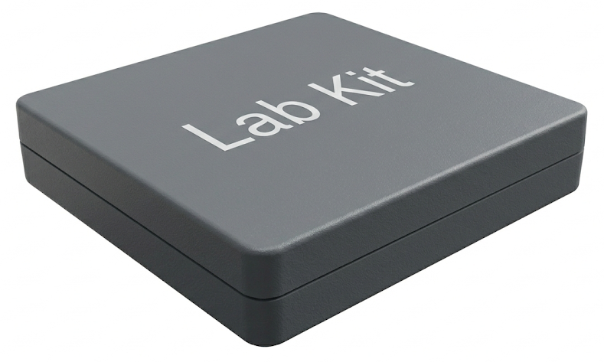
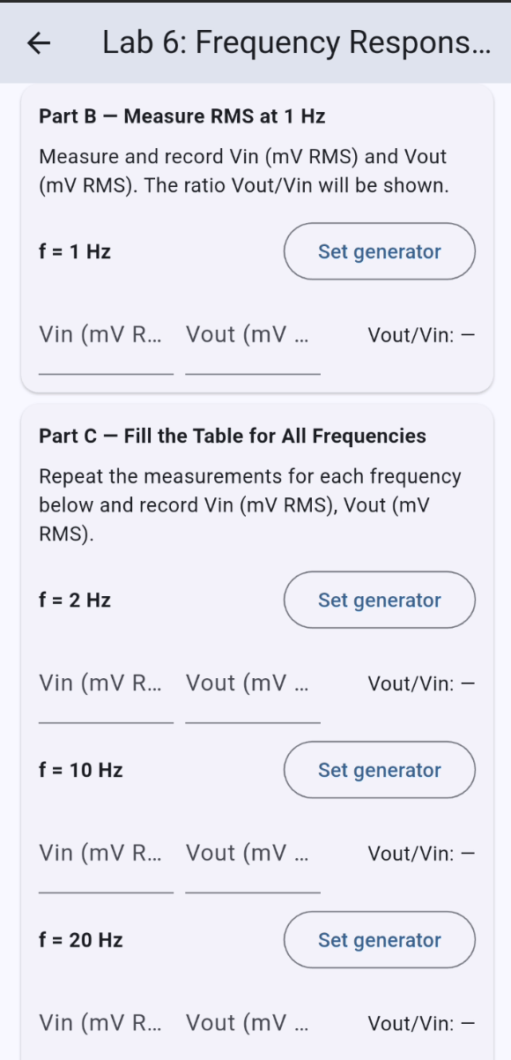
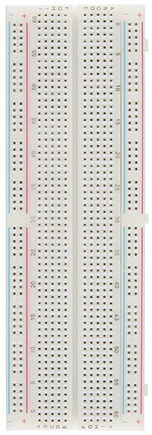
Integrated System Diagram
BLE
BLE
Lab Kit System
User’s Breadboard
Notes:
Eric

Slide 4
Project Timeline
2/9 | 2/23 | 3/9 | 3/16 | 3/30 | 4/20
Finalize PCB & order Phone-MCU BLE Validation | Soldered backup PCB Begin App Integration | Solder big PCB | DAC fully integrated | Integrate signal gen Integrate oscilloscope | Final Demo
Notes:
Eric

Slide 5
Power Supply/Signal Generator Gavin Bernard
Accomplishments since last update 18 hrs of effort | Ongoing progress/problems and plans until the next presentation
Validated 5 Volt Buck Converter with 4.988 volts Validated 3.3 Volt Buck Converter with 3.299 volts Validated -5 Volt Charge Pump Inverter with -4.928 volts Validated Variable Voltage Control with 99% accuracy and fixed connective issue with the App Signal Generator operational with frequency and waveform | Fix Signal Generator amplitude Fix connective issue from Micro-USB and ESP32

Slide 6
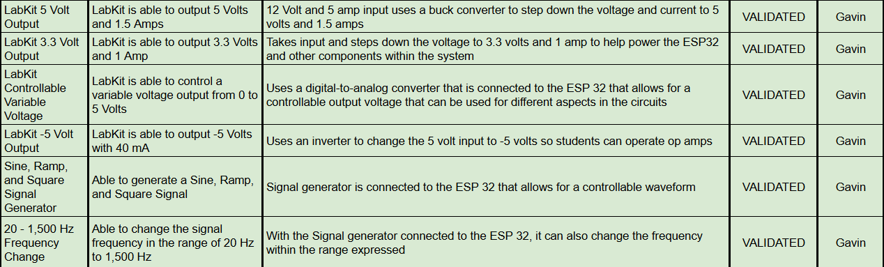
Power Supply/Signal Generator Gavin Bernard

Slide 7
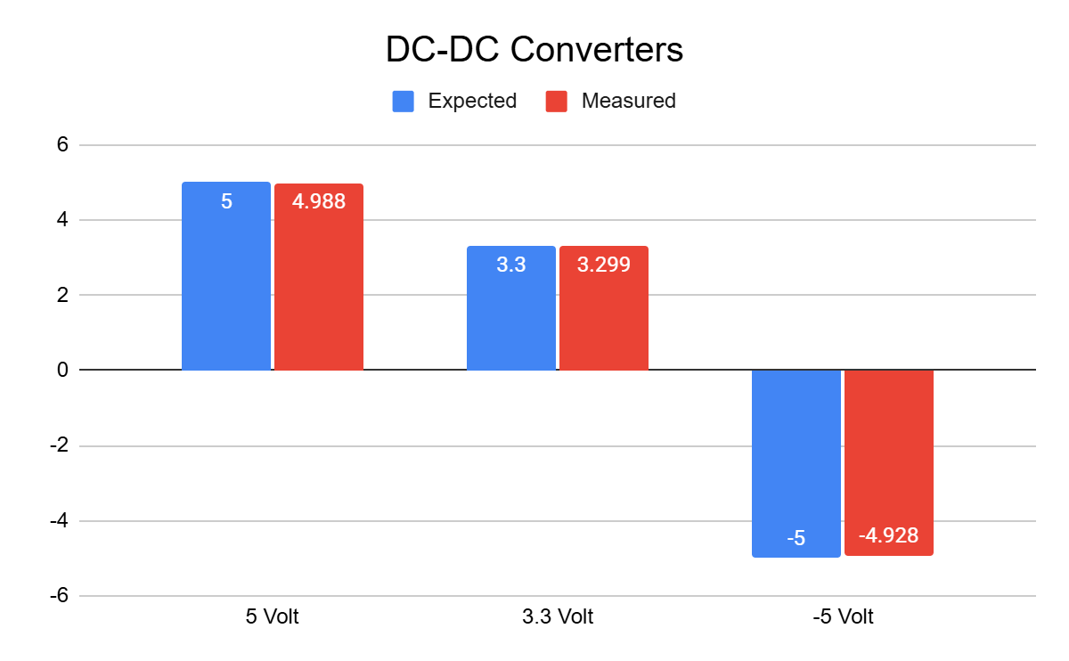
Power Supply/Signal Generator Gavin Bernard

Slide 8
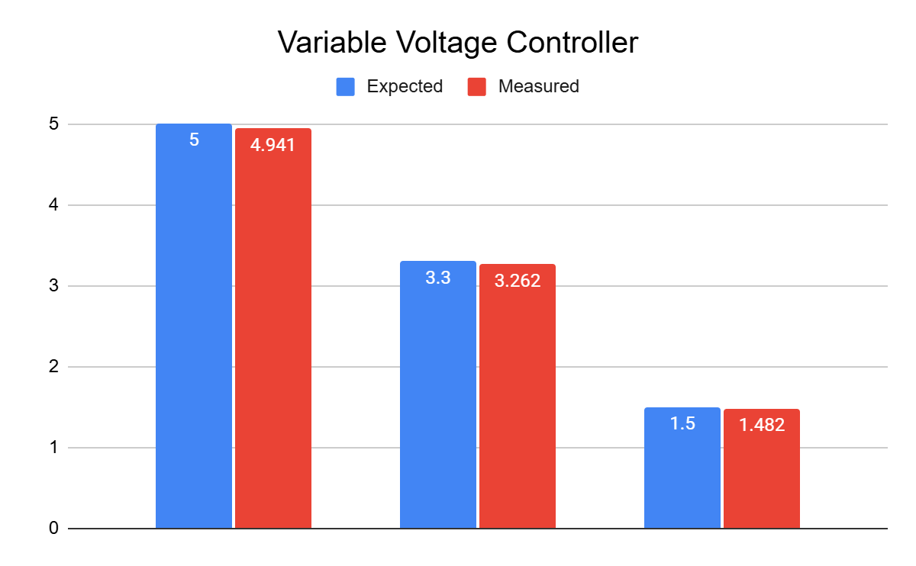
Power Supply/Signal Generator Gavin Bernard

Slide 9
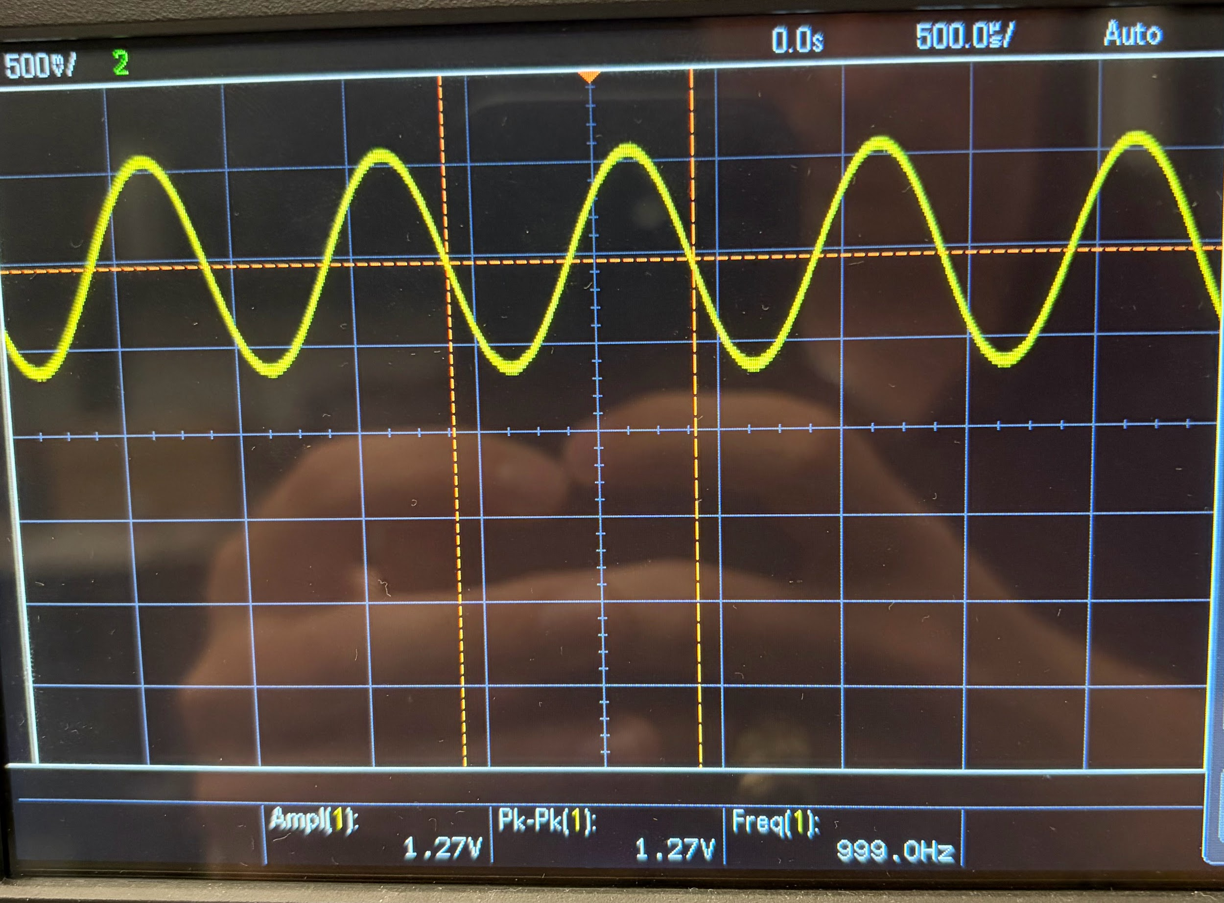
Power Supply/Signal Generator Gavin Bernard

Slide 10
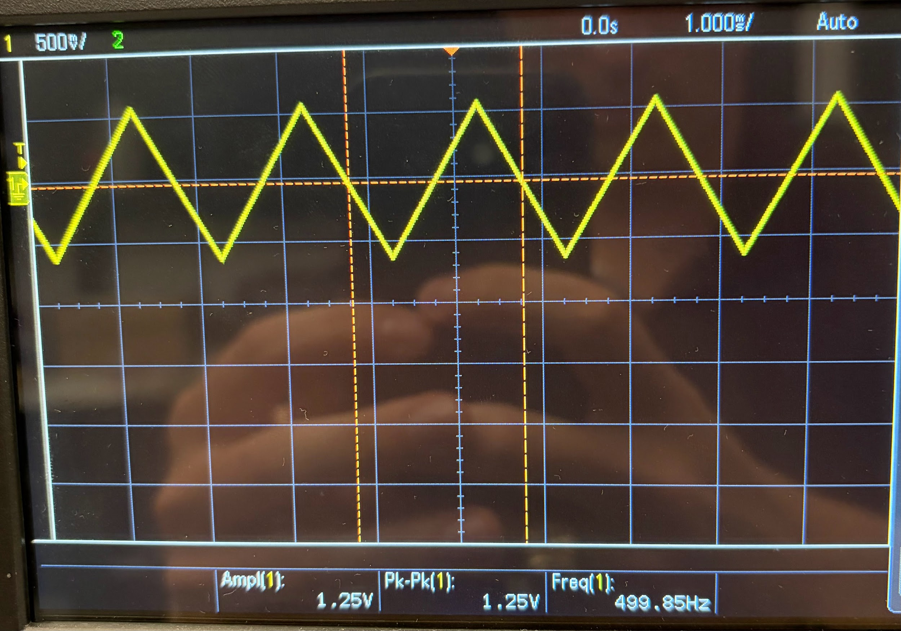
Power Supply/Signal Generator Gavin Bernard

Slide 11
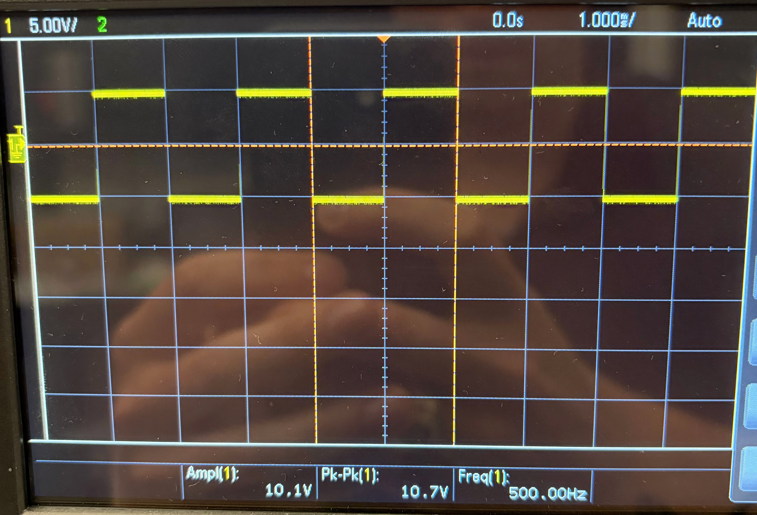
Power Supply/Signal Generator Gavin Bernard

Slide 12
Measurement Subsystem Maylun Huang
Accomplishments since last update 14 hrs of effort | Ongoing progress/problems and plans until the next presentation
Validated voltmeter, & single channel oscilloscope In progress validating ohmmeter & dual channel oscilloscope | Fully validate ammeter & second channel of oscilloscope

Slide 13
Measurement Subsystem Maylun Huang
Voltmeter
Input | Code Reads | Actual
[V] | [V] | [V]
-5 | 0.11 | -5.01 ± 0.07
0 | 1.62 | -0.1 ± 0.1
-5 | 3.23 | 4.98 ± 0.03

Slide 14
Measurement Subsystem Maylun Huang
Ohmmeter
Component | Raw Input | Actual
[Ω] | [V] | [Ω]
10 | 3 | 10 ± 0.02
100 | 1.65 | 99 ± 0.08
100 | 3 | 102 ± 0.04
1000 | 1.65 | 987 ± 5

Slide 15
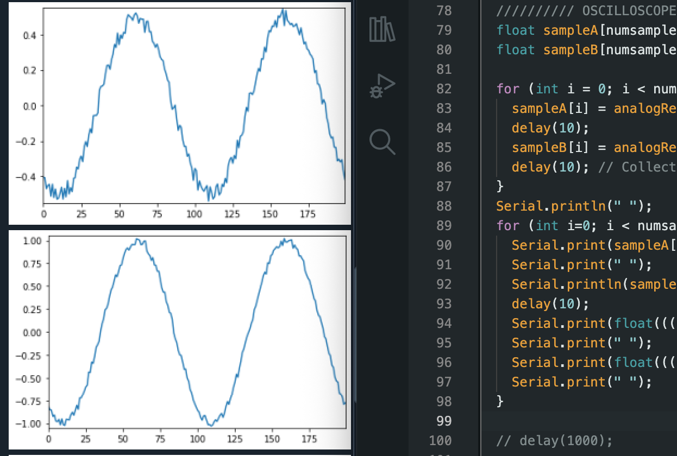
Measurement Subsystem Maylun Huang
Sin Wave, 1V amplitude
100 Hz →
1kHz →

Slide 16
Mobile App Evan Slyter
Accomplishments since last update 8 hrs of effort | Ongoing progress/problems and plans until the next presentation
-Updated MCU code multiple times to fix reconnection and DAC output issues. -Validated range of app connection -Validated time to send to MCU from app -Validated time to connect to app -Validated connection through obstacles -Validated app-MCU data accuracy | -Integrate Oscilloscope -Integrate Signal Gen -Continue to update code as new problems appear during integration.

Slide 17
Mobile App Evan Slyter
Trial 1, Flat
0ft | 2ft | 4ft | 8ft | 10ft | 12ft
+ | + | + | + | - | -
Trial 2, Holding
0ft | 2ft | 4ft | 8ft | 10ft | 12ft
+ | + | + | + | + | +

Slide 18
Mobile App Evan Slyter
Trial 1, Flat
0ft | 2ft | 4ft | 8ft | 10ft | 12ft
0.3s | 0.3s | 5s | 17s | N/A | N/A
Trial 2, Holding
0ft | 2ft | 4ft | 8ft | 10ft | 12ft
0.3s | 0.3s | 0.3s | 1.5s | 2s | 7s

Slide 19
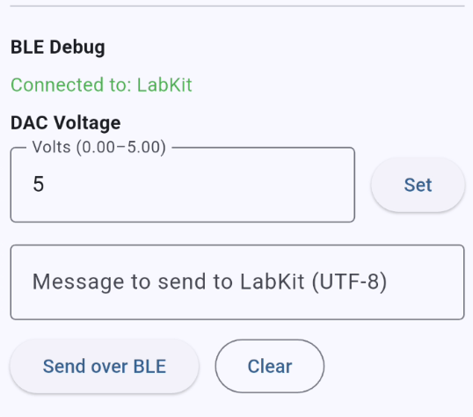
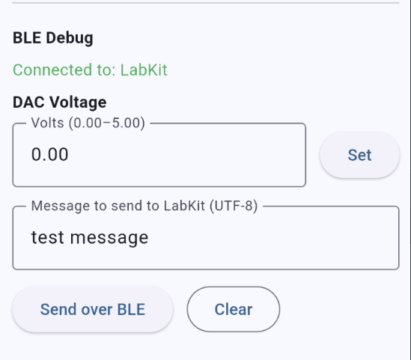
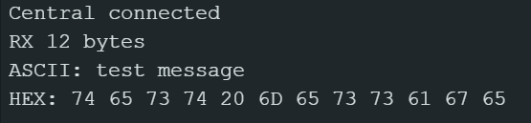

Mobile App Evan Slyter

Slide 20
Mobile App Evan Slyter
Previously failed. Fixed previous issue of command being received by MCU but output not changing.

Slide 21
Mobile App Evan Slyter
Trial 1
Case Only | Case + Door | Case + Blanket | Case + Desk
+ | + | + | +
Trial 2, 6ft
Case Only | Case + Door | Case + Blanket | Case + Desk
+ | + | + | +

Slide 22
Mobile App Evan Slyter
Trial 1, Flat
0ft | 2ft | 4ft | 8ft | 10ft | 12ft
Instant | Instant | Instant | Instant | 0.3s | 0.3s
Trial 2, Holding
0ft | 2ft | 4ft | 8ft | 10ft | 12ft
Instant | Instant | Instant | Instant | Instant | Instant

Slide 23
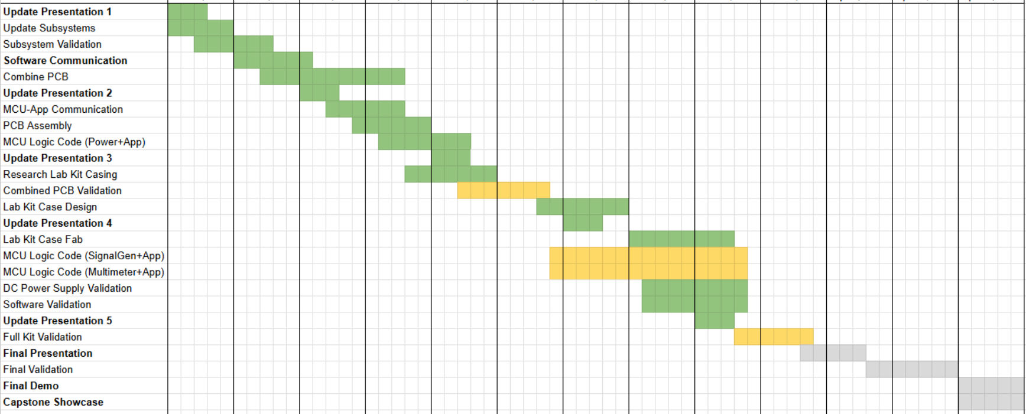
Execution Plan
Notes:
Michelle

Slide 24
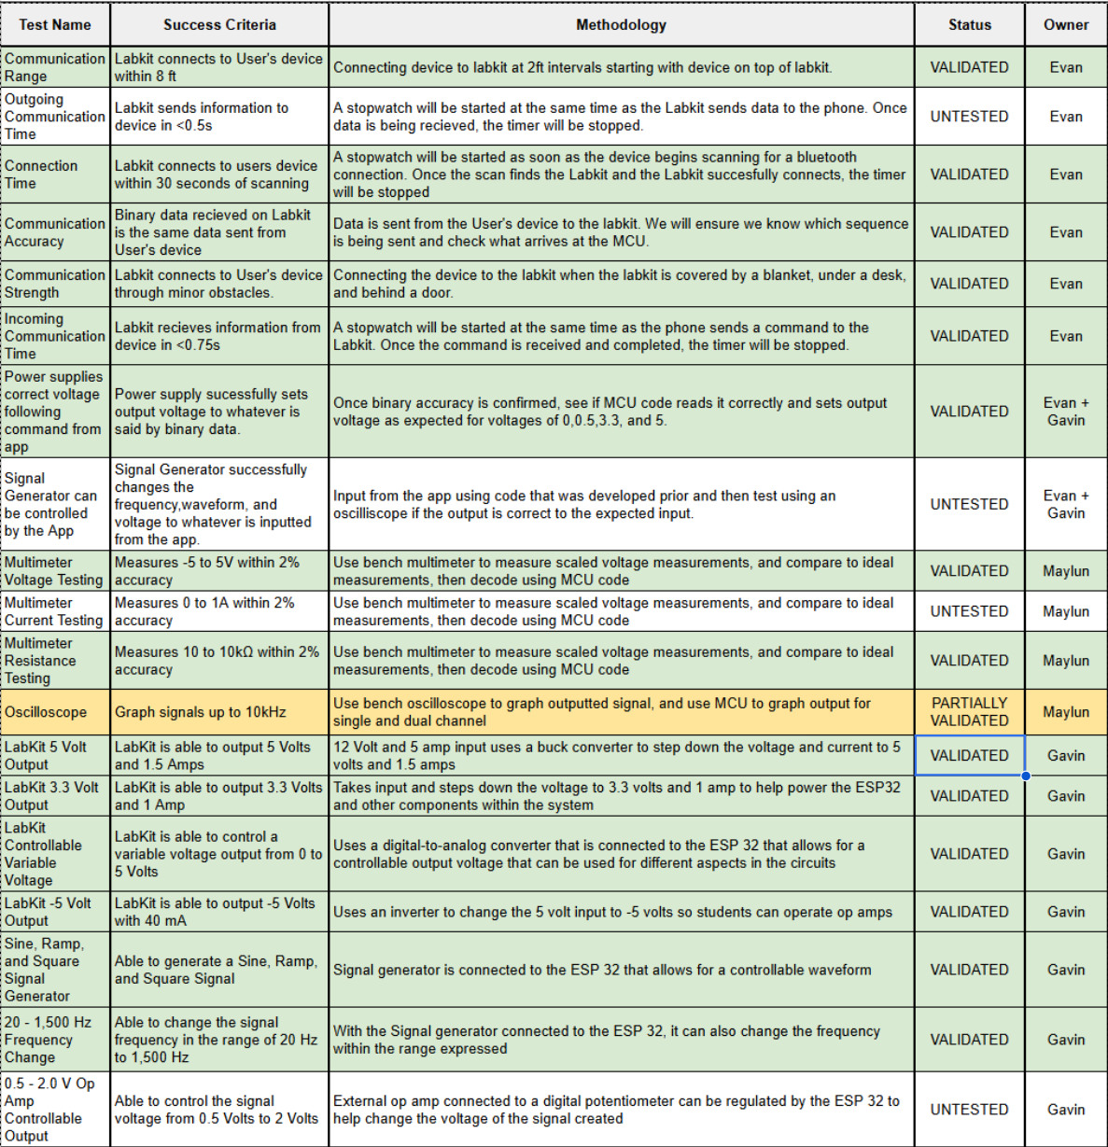
Validation Plan
Notes:
Michelle

Slide 25
Questions?

